Slide 1
Predicting Traffic Accident Severity
Applied Data Science Capstone
Pablo Sanhueza Toro

Slide 2
Traffic accidents are...
Cause of 1.35 million deaths globally in 2016.
Main cause of death among those aged 15–29 years. Predicted to become the 7th leading cause of death by 2030.
Predicting the accident severity in advance could be used to send the exact required staff and equipment to the place of the accident, thus saving a significant amount of lives each year.
Road safety should be a prior interest for governments, local authorities and private com-
panies investing in technologies that can help reduce accidents and improve overall driver safety.

Slide 3

Data
All the recorded accidents in France from 2005 to 2016, both years included.
Initial dataset from the Kaggle, here. Pre-selcted features on my GitHub, here
In total 49 features, 839,985 rows in the Kaggle dataset Redundant and not relevant features were dropped
29 features pre-selected
On the data cleaning missing values and outliers were replaced.

Slide 4
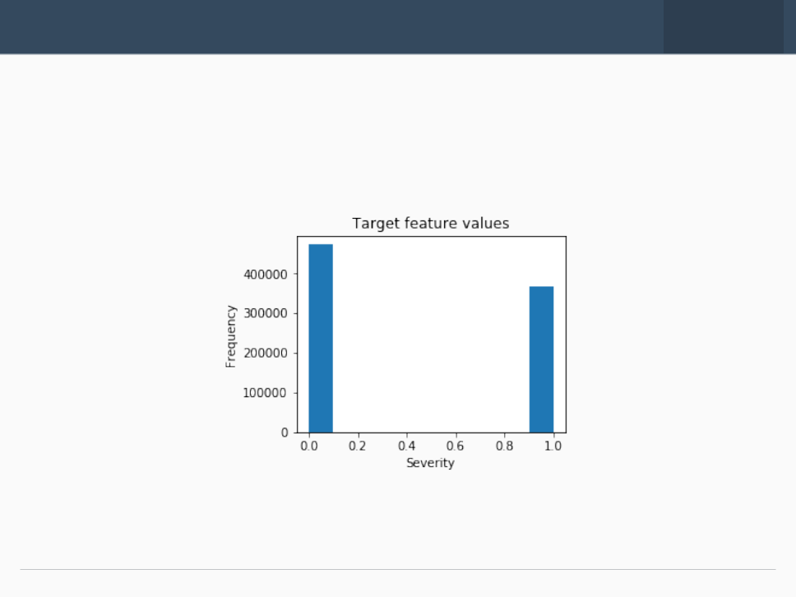
EDA-Target
The target feature a binary classifier, describing the accident severity.
0: low severity.
1: high severity, from hospitalized wounded injuries to death.
It is a balanced labeled dataset with more cases of lower severity.

Slide 5
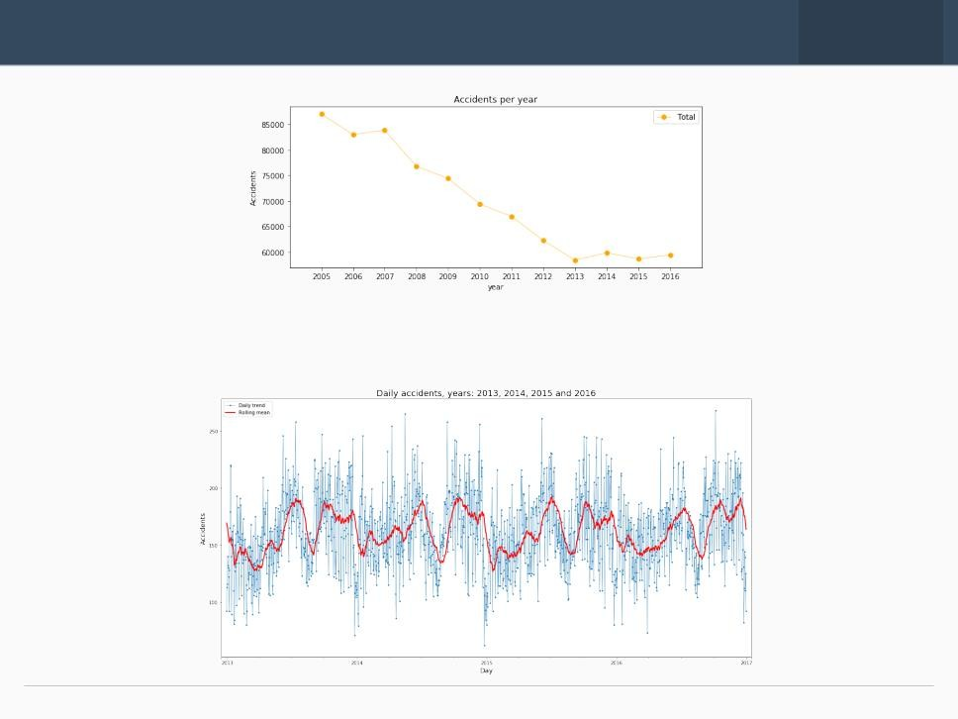
EDA-Seasonality
The number of traffic accidents decreased over the years from 2005 to 2013, after
which the trend became stable.

Slide 6
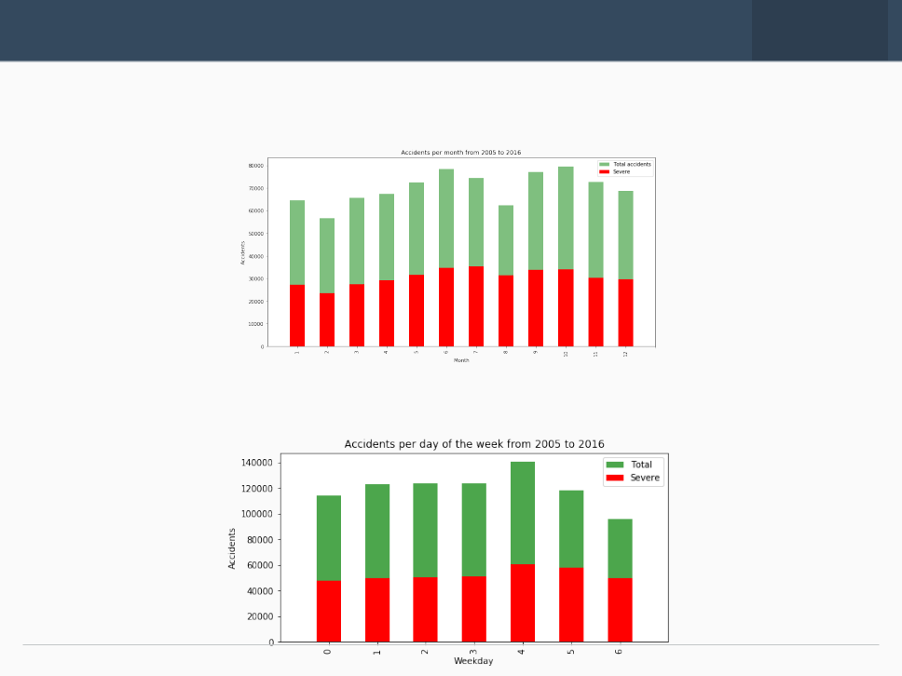
EDA-Seasonality
Accidents increase from March to June and then again in September, decreasing at
the end of the year.
Steady trend during the week. More accidents on Friday and less on Sunday

Slide 7
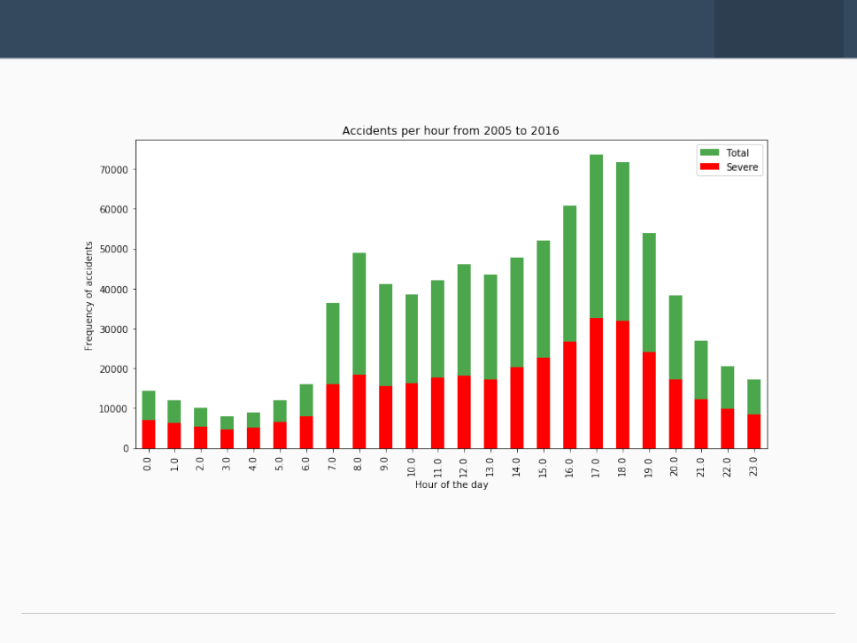
EDA-Seasonality
The trend of highly severe accidents is proportional to the global trend.
Spikes:
8am: people go to work 5-6pm: people return home.

Slide 8
Classification Models
Random Forest:
10 decision trees
maximum depth of 12 features
Logistic Regression c=0.001
K-Nearest Neighbor
K=16
Supervised Vector Machine
Due to computation inefficiency, training size was reduced to 75,000 samples.

Slide 9
Results
This table reports the results of the evaluation of each model.
Algorithm | Jaccard | f1-score | Precision | Recall | Time(s)
Random Forest | 0.722 | 0.72 | 0.724 | 0.591 | 6.588
Logistic Regression | 0.661 | 0.65 | 0.667 | 0.456 | 6.530
KNN | 0.664 | 0.66 | 0.652 | 0.506 | 200.58
SVM | 0.659 | 0.65 | 0.630 | 0.528 | 403.92
With no doubt the Random | Forest is the | best model, | in the same | time as the log. res. it
improves the accuracy from 0.66 to 0.72 and the recall from 0.45 to 0.59.

Slide 10
Conclusion and future projects
Built useful models to predict the severity of a traffic accident. Accuracy of the models has room for improvement.
Future projects:
Add features such as vehicle speed and time of uninterrupted traveling. Prediction of potential accident, critical spots and time.

